Slide 1
Week 1

Slide 2
Note to Teacher…
It is essential that you emphasize decomposing and recomposing numbers, especially with addition.
Please expose and emphasize the importance of the empty number line.
Students should be adding and subtracting with place value, not the standard algorithm.

Slide 3
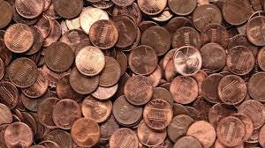
Math Corner-Monday
Jackie has 476 pennies. She used 278 pennies to buy some balloons.
Part A
How many pennies does Jackie have left? Explain your thinking and show your work?
Part B
If Jackie didn’t spend her pennies, how many more coins would she need to have 500 pennies? What strategy can you use to prove your thinking?

Slide 4

Math Corner-Tuesday
David has 75 balloons. He lost 29 of them. How many balloons does he have left? Solve this problem two ways.
Number Talk…
The problem is 50-21. Solve it as many different ways as you can using MENTAL MATH ONLY.

Slide 5

Math Corner- Wednesday
Mrs. Johnson’s daughter practiced her violin for 145 minutes on Monday, and 299 minutes on Tuesday.
How many minutes did she practice in all?
Prove your thinking using pictures, numbers, and words.

Slide 6
Math Corner-Thursday
The bakery had 43 bread rolls to sell. It sold 16 of the rolls. How many rolls did the bakery have left?

Slide 7
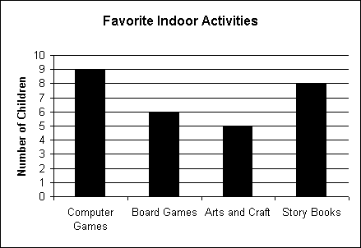
Math Corner-Friday
Use the graph below to answer the question.
1. How many students like to read story books and play computer games?
2. How many more students liked computer games than board games?
3. How many students took this survey?
4. List the activities from most favorite to least favorite.
A Step Further…
Dora’s chapter book has 435 pages. Tara’s book has 399 pages. How many pages are there in BOTH girls’ books altogether?

Slide 8
Week 2

Slide 9
Math Corner-Monday
The teacher wrote the following problem on the board:
365 + = 475
Part A
How can you use an open number line to solve for the missing number?
Part B
What other strategy can be used to find out if your answer is correct?

Slide 10
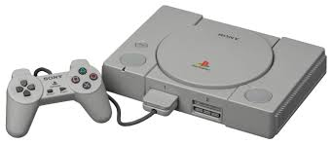
Math Corner-Tuesday
I had 500 dollars. I bought a PlayStation for 275 dollars.
How much money did I have left?
Explain your thinking by using at least 2 strategies.
Which strategy helped you the most? Explain your reasoning.

Slide 11

Math Corner-Wednesday
John bought some flowers on Wednesday. On Thursday, he had 133 more. On Friday he had 167 in all.
How many flowers did he buy on Wednesday?
Close your eyes to make a picture in your mind. What strategy can you use to understand and prove your thinking?

Slide 12
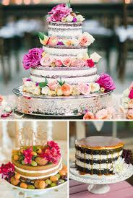
Math Corner-Thursday
A shop sold 289 cakes last week.
This week the shop sold even more cakes. Now they have sold 356 cakes in all.
How many cakes did the shop sell this week?
Close your eyes to make a picture in your mind. What strategy can you use to understand and prove your thinking?

Slide 13
Math Corner-Friday
Use the graph below to answer the question.
Make a data chart to record the information from this graph.
Use the data to create a pictograph.
How is a bar graph different from a pictograph?
Which graph do you like better? Explain your thinking.

Slide 14
Week 3

Slide 15

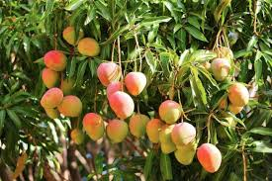
There are 287 mango trees in a big garden. 135 of them have fruits.
How many mango trees do not have fruits?
How can you use a number line as a tool?
How would you represent the problem using base ten blocks?

Slide 16

Math Corner-Tuesday
Melanie ate 265 ice-creams last year. This year she ate 177 ice creams less than last year.
How many ice-creams did she eat this year?
Show your thinking using two different strategies.

Slide 17
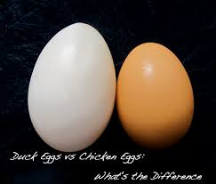
Math Corner-Wednesday
A farmer has 174 chicken eggs. He has 288 duck eggs.
How many more duck eggs are there compared to chicken eggs?

Slide 18
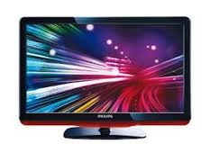
Math Corner-Thursday
A television set costs $615.
If you pay with $700, how much change will you get back?
Use pictures, number, or words to show your strategy.

Slide 19
Math Corner-Friday
Color | Number of Votes
Red | 13
Blue | 10
Orange | 7
Mel’s teacher gave her this chart about favorite colors. 1.
Create a bar graph using this data.
Create a pictograph using this data
Write down three observations about your data.
Write two questions for a friend to solve from your data.

Slide 20
Additional slides

Slide 21
Math Corner-Wednesday
Use the graph below to answer the question.
1. How many more students liked story books than arts and crafts?
2. How many students liked computer games, board games, and storybooks altogether?
3. List the activities from least favorite to most favorite.
Review
Today’s number is 3,406. Represent this number using:
Expanded Form
Word Form
Place Value Models

Slide 22
Math Corner-Thursday
Use the graph below to answer the question.
Use the data from this vertical bar graph to create a horizontal bar graph.
Explain the similarities and differences between the two graphs.
Challenge!
Determine the number of students who took this survey. How many more students would need to take this survey to equal 100?

Slide 23
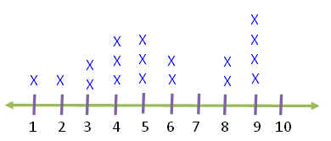
Math Corner-Friday
Number of Coins
Mrs. Amerson took a survey to collect data about the number of coins in students’ pockets. This line plot graph shows the results of her survey. Use this data to answer the questions.
How many students took the survey?
How many students had 9 coins in their pockets? 10?
Did anyone have 4 coins? How do you know?
How many students had 6 or more coins in their pockets?

Slide 24
Math Corner-Monday
Mel’s teacher gave her this chart about favorite colors. Her teacher told her to use this chart to make a graph. Help her out!
Challenge: Write 3 questions about this table. Let your neighbor answer them.
Color | Number of Votes
Red | 13
Blue | 10
Orange | 7

Slide 25

Math Corner-Tuesday
Welcome to Mrs. Freeman’s Candy Shop! Use the menu below to answer the question below.
Tim, Kim, and Jim each only have $1.00 to spend. They each had different orders. Create a possible order for each person. Remember, you can buy any item more than once.
**Challenge! Can you think of more combinations?
Item | Price
Blow Pops | $0.25
Air Heads | $0.15
Ring Pops | $0.50
Sour Patch Candy | $0.65
Reese’s Cups | $0.75
Snicker | $1.00
Twix | $0.85

Slide 26
Math Corner-Wednesday
Welcome to Mrs. Freeman’s Candy Shop! Use the menu below to answer the question below.
I need to buy three Blow Pops, 1 Sour Patch, and a Reese’s Cup. What is my total?
**A Step Further…What would be my change if I gave the cashier a 5 dollar bill?
Item | Price
Blow Pops | $0.25
Air Heads | $0.15
Ring Pops | $0.50
Sour Patch Candy | $0.65
Reese’s Cups | $0.75
Snicker | $1.00
Twix | $0.85

Slide 27
Math Corner-Thursday
Welcome to Mrs. Freeman’s Candy Shop! Use the menu below to answer the question below.
If I buy a Ring Pop and a Twix Bar, what would be my change if I give the cashier $2.00?
**Challenge! What would be my total if I wanted to buy one of everything on the menu?
Item | Price
Blow Pops | $0.25
Air Heads | $0.15
Ring Pops | $0.50
Sour Patch Candy | $0.65
Reese’s Cups | $0.75
Snicker | $1.00
Twix | $0.85

Slide 28
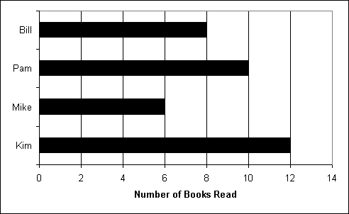
Math Corner-Friday
This graph shows the number of books Bill, Pam, Mike,
and Kim read last month.
How many books did Kim, Bill, and Mike read altogether?
How many books were read in all?
CHALLENGE! How many more books do the kids need to read to equal 100?

